Slide 1

S7 PROJECT FINAL REVIEW
FlexaScale
Reinforcement Learning-Based Intelligent Auto-Scaling
Framework for Distributed Microservices on Kubernetes
Guided by
Dr. Lakshmi Mohan, Department of CSE
Atmakrishna K Raghavan AM.SC.U4CSE23015
Dattanand U D AM.SC.U4CSE23023
G O Ashwin Praveen AM.SC.U4CSE23027
Ghanshyam S Sunil AM.SC.U4CSE23029
Team A1 · Amrita School of Computing, Amritapuri · November 2026
Notes:
Good morning. We are Team A1. Our project is FlexaScale, a reinforcement-learning autoscaler for microservices on Kubernetes, guided by Dr. Lakshmi Mohan. In the next twenty minutes we will show what we built, how we verified it on a live cluster, and what a fair evaluation against Kubernetes' own autoscaler found.

Slide 2
Outline
1
Introduction
7
Proposed Methodology
13
Future Work
2
Problem Definition
8
Proposed Approach
14
Team Contribution
3
Objectives
9
Evaluation Setup and Criteria
15
Appendix A: Code and Demo
4
Literature Review
10
Results and Analysis
16
Project Time Line
5
Research Gap
11
Discussion and Limitations
17
Reference
6
Datasets, Platforms and Tools
12
Conclusion
FlexaScale
Notes:
This is the order we will follow, which is the order of the review template.

Slide 3
Introduction
Background and motivation
1
Microservices run on Kubernetes
Sustainable Development Goals
An online shop is many small services. Kubernetes keeps N replicas of each one running.
SDG
9
Industry, Innovation and Infrastructure
2
The default autoscaler is simple
Target 9.4: resource-efficient, reliable cloud infrastructure
The HPA scales each service on its own CPU: desired = ⌈replicas × CPU / target⌉, then waits 5 min before scaling down.
3
Simple rules leave gaps
SDG
12
Responsible Consumption and Production
It cannot see call dependencies or non-CPU bottlenecks, and it keeps spike capacity long after a spike.
Target 12.2: fewer idle replicas, less allocated compute
4
Our aim
Let a learned, dependency-aware policy scale the services, without giving up the HPA's safety.
Demonstrated on a laptop cluster; production-scale savings are expected, not measured.
Notes:
Modern applications are split into microservices. Kubernetes runs them, and its Horizontal Pod Autoscaler adds or removes replicas by looking at one service's CPU. That rule is simple and safe, but it ignores how services call each other and it is slow to scale down. FlexaScale asks whether a learned policy that sees the whole call graph can do better, safely. The work maps to SDG 9 and SDG 12 through more efficient, reliable infrastructure.

Slide 4
Problem Definition
Problem statement
Choose the replica count of every service, every 10 s, so that the application uses as few replica-hours as possible while end-to-end p95 latency stays ≤ 1000 ms, and the cluster stays safe.
Safety
Exclusive control
Graceful fallback
Bounded actions: one bad decision must not overload the node or empty a busy service.
Each service has an HPA. Exactly one controller may own a service at a time.
If telemetry fails, the controller crashes or the policy is unsure, the HPA takes over.
What we measured with the default HPA
27
+15%
10×
replicas at the flash-sale peak, kept for 5 min after it ended
replica-hours in checkout-heavy load, for a brief CPU rise
order-service latency rise while its CPU stayed at 30-50% of limit
Notes:
Formally, at every ten-second step we choose replica counts for all services. We want the fewest replica-hours while keeping the end-to-end 95th-percentile latency under one second. Three practical requirements make it hard: safety, exclusive control with the HPA, and graceful fallback. The numbers at the bottom are our own measurements of where the default HPA wastes resources or misses a bottleneck.

Slide 5
Objectives
O1
Framework
O2
RL decision engine
O3
Dependency-aware
Autoscaling add-on for Kubernetes microservices; no application code changes
PPO policy that learns from simulated workloads and runs on live metrics
Reason over the service call graph with a graph neural network
Evaluated by: Shop (16) and bookstore (5)
Evaluated by: Twin validation, live inference
Evaluated by: Graph vs no-graph ablation
O4
Safe operation
O5
Fair evaluation
O6
Deployment & monitoring
Bounded actions, exclusive ownership, automatic fallback to the HPA
Compare with default and tuned HPA on latency, cost and SLO
Real-time dashboard and Helm packaging
Evaluated by: Fault injection, cleanup checks
Evaluated by: Pre-registered paired study, 95% CI
Evaluated by: Live runs, Helm lifecycle 33/33
Notes:
We set six objectives, each tied to how it is evaluated. O1 to O3 are about building the learned, dependency-aware framework; O4 is safety; O5 is a fair evaluation against both the default and a tuned HPA; O6 is deployment and monitoring.

Slide 6
Literature Review
Twelve primary papers, 1-6
Paper | Year | Key contribution | Dataset / setting | Evaluation metrics | Demerit / gap
Gwydion [1] | 2025 | RL autoscaler with dependency-aware state; cost + latency reward | Kubernetes; Redis Cluster, Online Boutique | Latency, resources vs HPA | Horizontal only; default-HPA baseline
Smart HPA / ProSmart [2] | 2025 | Reactive and ML-predictive resource-efficient HPA | Kubernetes microservice benchmark | Utilisation, over/under-provisioning | No RL; dependencies not modelled
RL autoscaling [3] | 2025 | PPO/DDPG, horizontal + vertical scaling | Amazon EKS, Spark TPC-DS | Cost, performance | Long training; no dependencies
AdaptScale [4] | 2020 | Adaptive prediction + greedy heuristic for multiple SLAs | Simulation platform | SLA satisfaction, resources | Cloud data scaling; greedy
KubCG [5] | 2021 | Scheduler using execution history | Heterogeneous CPU-GPU cluster | Job completion time | Placement, not autoscaling
Rossi et al. [6] | 2019 | Model-based RL for horizontal + vertical elasticity | Simulation; Docker Swarm | Performance, resource, adaptation cost | Single app; no dependencies
Notes:
We reviewed twelve primary papers. The first group are learned and rule-based autoscalers. Gwydion is the closest to us: RL with dependency information on Kubernetes, but compared only with the default HPA.

Slide 7
Literature Review
Twelve primary papers, 7-12
Paper | Year | Key contribution | Dataset / setting | Evaluation metrics | Demerit / gap
FIRM [7] | 2020 | SVM critical-path localisation + DDPG reprovisioning | Kubernetes; DeathStarBench, Train-Ticket | SLO violations (up to 16× fewer), CPU | Needs tracing; acts on limits
Autopilot [8] | 2020 | Recommenders + ML meta-algorithm at Google | Borg production fleet | Slack 23% vs 46% manual, OOMs | Needs fleet history
Sinan [9] | 2021 | CNN + boosted trees predict QoS risk | DeathStarBench; local and GCE | QoS met, resources | Large per-app data collection
GRAF [10] | 2021 | GNN latency model + joint CPU optimisation | Kubernetes benchmarks | CPU allocation, SLO | Per-app model; needs forecasts
Alibaba trace [11] | 2021 | Production microservice trace and analysis | >20,000 services | Topology, dynamics | No controller evaluated
DeathStarBench [12] | 2019 | Open-source end-to-end microservice apps | Real servers, cloud/edge | Latency, tail effects | Heavy for small hardware
Notes:
The second group: FIRM and Sinan use learning to find the critical service; Autopilot shows how strong well-engineered rules are in production; GRAF uses a graph neural network; the Alibaba trace and DeathStarBench describe realistic workloads.

Slide 8
Research Gap
Identified from the twelve reviewed works
Gap in the literature
How FlexaScale addresses it
Baselines are weak
Compare with default and a calibrated, tuned HPA under rules fixed before the runs
Learned autoscalers are compared with the default HPA, so it is unknown how much a tuned rule would also gain.
Coexistence is ignored
Per-service Auto arbitration, Lease + HPA freeze, verified fallback
Few works say who owns a service, or what happens when telemetry or the controller fails.
Graph benefit is assumed
Graph vs no-graph ablation on three held-out test sets
Dependencies are used in many ways, but their benefit is rarely isolated.
Notes:
Three gaps stood out. Baselines are usually the default HPA. The coexistence of a learned controller with the native one is rarely designed. And the benefit of dependency information is seldom measured on its own. FlexaScale answers each one.

Slide 9
Datasets, Platforms, and Implementation Tools
Category | Used in FlexaScale | Purpose
Dataset | Alibaba microservice trace v2021 (7.4 GB raw → 36,355 rows, split by service); calibration runs; 289+ live runs | Train v1-v6; fit the twin; evaluate
Platform | Kubernetes v1.31 on single-node Minikube (Docker driver) | System under control
Hardware | Laptop 1: Intel i5-1340P, 16 GB, Fedora 43 · Laptop 2: Ryzen 7 6800H, RTX 3050 4 GB, Windows 11 | Development, verification · GPU training, v9 evaluation
Learning | PyTorch 2.13, Stable-Baselines3 2.9 (PPO), Gymnasium 1.3 | GNN + PPO policy, simulators
Monitoring | Prometheus + Grafana (kube-prometheus-stack 92.11), cAdvisor | CPU, memory, request and latency metrics
Application & load | 16 FastAPI microservices, PostgreSQL 16, React frontend; Locust 2.46 | Test application and workloads
Control center | FastAPI lab server; React 18, TypeScript, Vite, Tailwind | Dashboard and experiment API
Packaging & testing | Helm chart 0.5.1, operator image 0.6.0; pytest (373 tests) | Installation; verification
Notes:
This table lists everything we used. Note the two laptops: the second one has a GPU, which we used to train the v9 policy and to run its pre-registered evaluation.

Slide 10
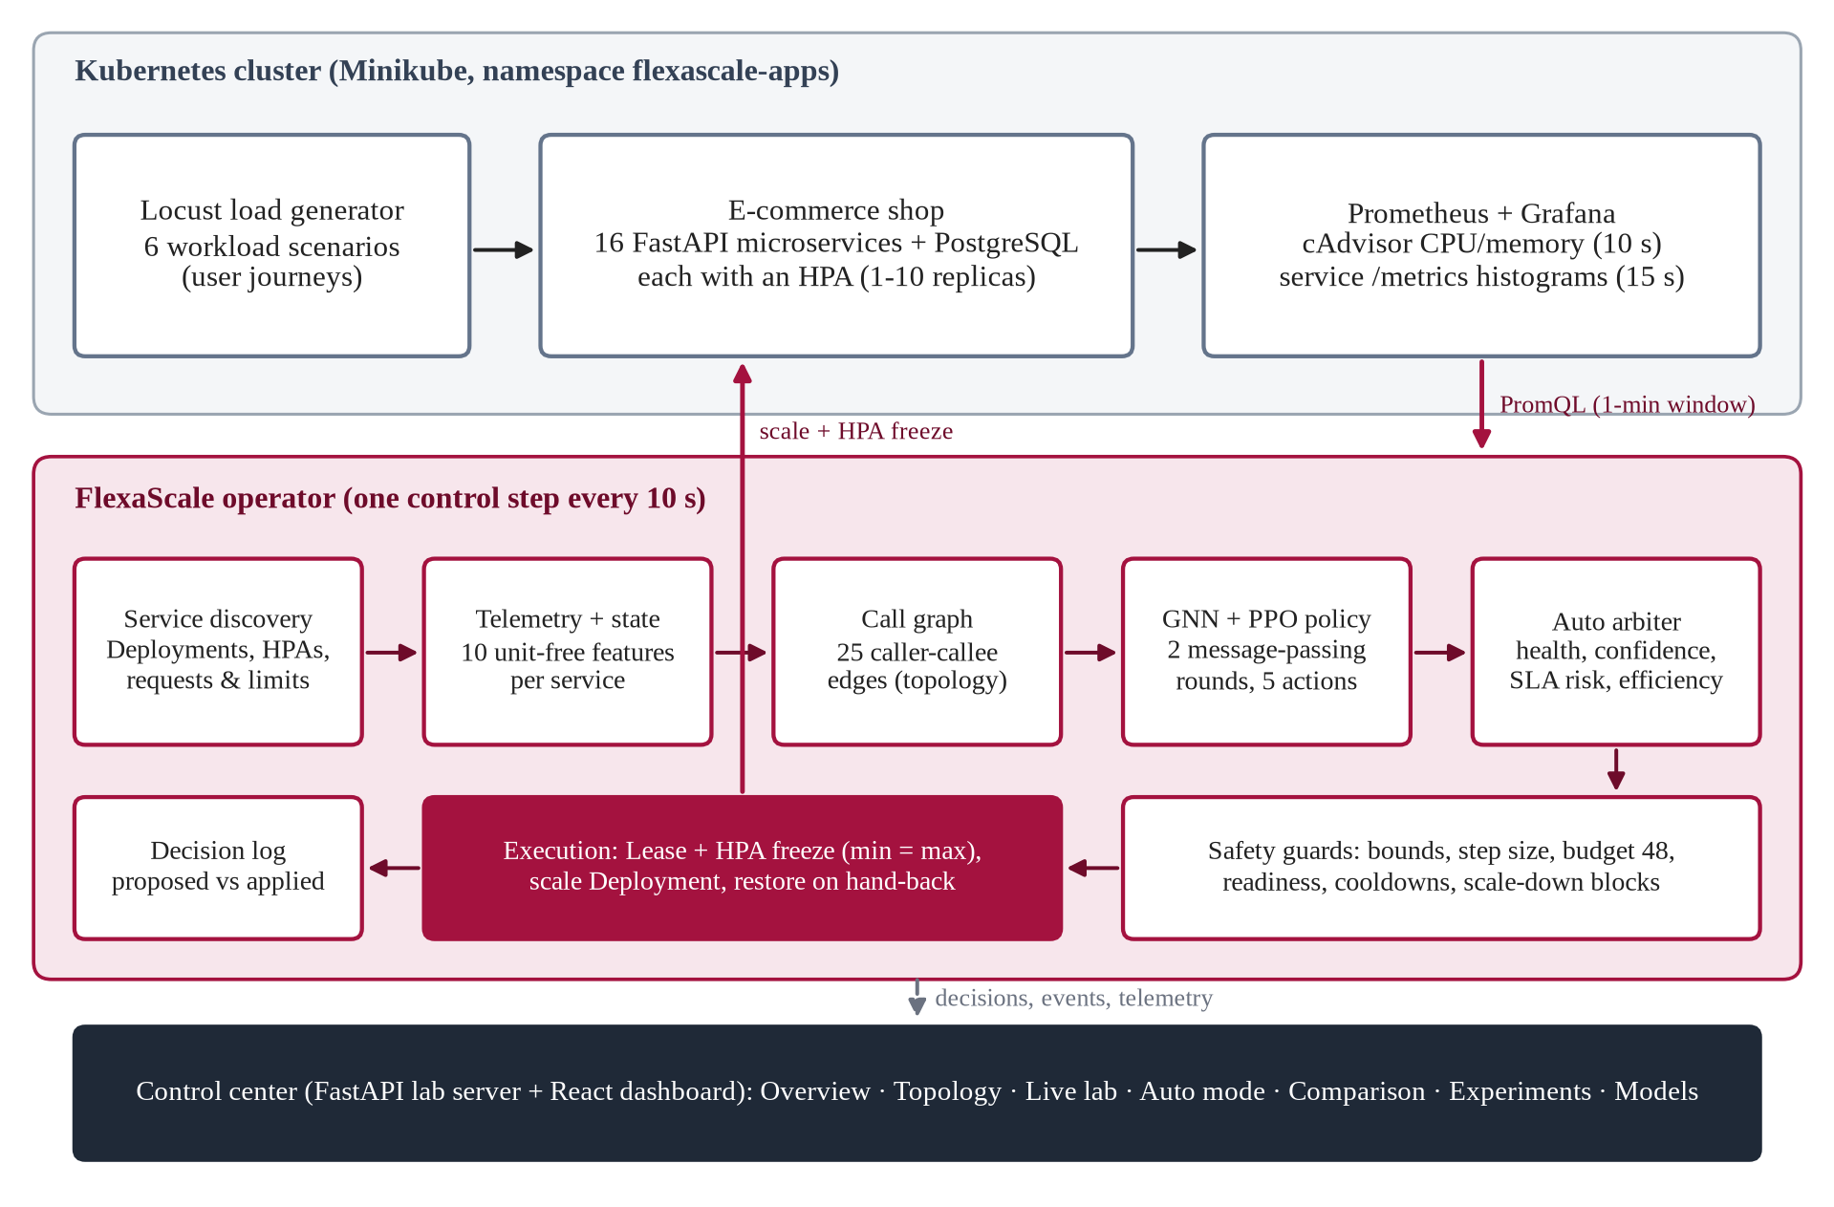
Proposed Methodology
Architecture: an add-on that controls the application from outside
Novelty
Graph policy
GNN message passing over the real call graph, PPO actor
Auto mode
Per-service choice between FlexaScale and HPA, with reasons
Exclusive ownership
Lease + HPA freeze; never two controllers on one service
Verified fallback
Telemetry loss, crash or Lease loss → HPA
Notes:
The upper panel is the application with its load generator and Prometheus. The middle panel is the FlexaScale operator, which runs every ten seconds: discovery, telemetry and features, the call graph, the GNN and PPO policy, the Auto arbiter, safety guards and execution. The lower panel is our control center. The four novelty points are on the right.

Slide 11
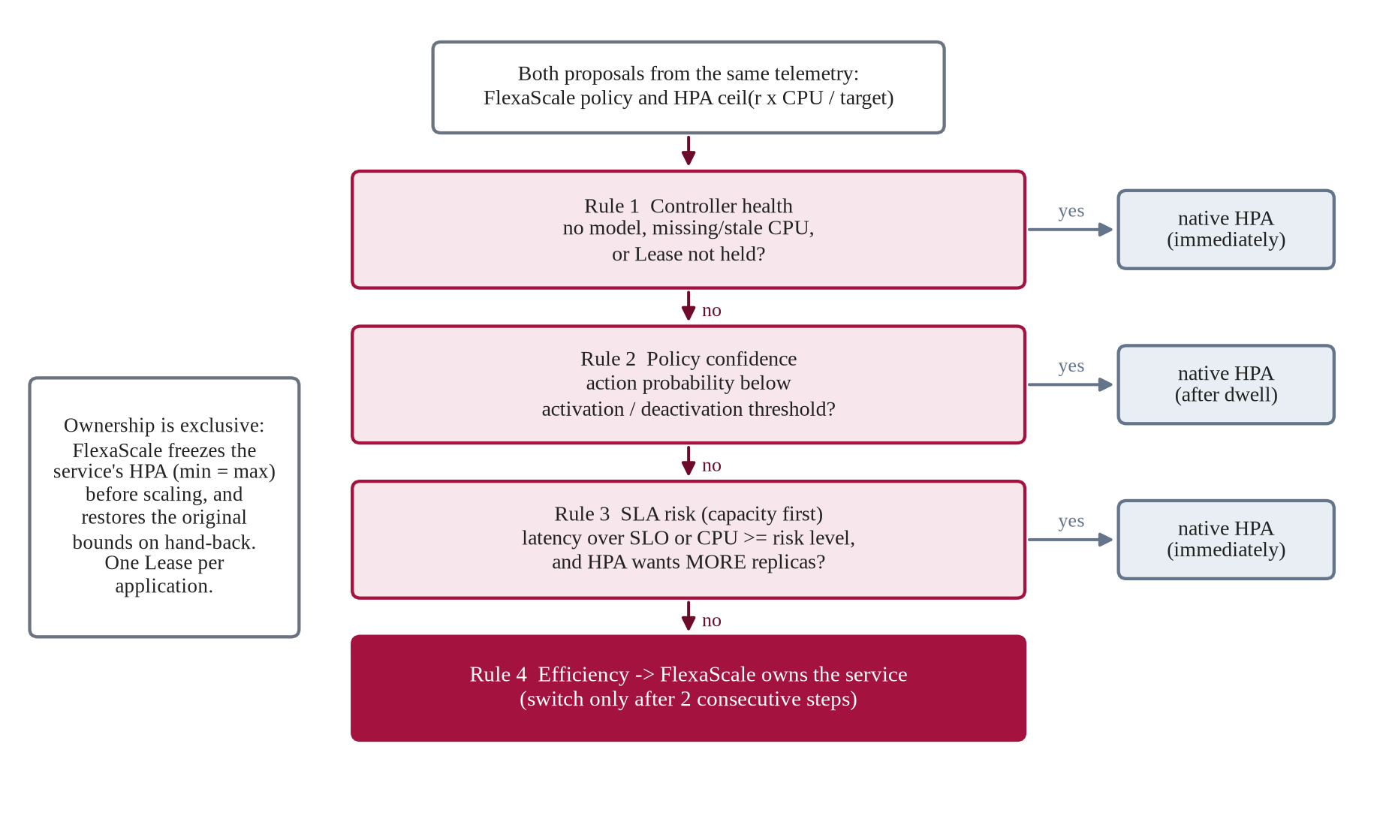
Proposed Methodology
Auto mode and the safety layer
Safety guards
• Replicas within 1-10
• At most +3 / −1 per step
• Budget: 48 replicas in total
• Cooldowns 20 s up, 30 s down
• No scale-up while pods start
• No scale-down at CPU ≥ 400% of request
• Stale telemetry → HPA
Notes:
Auto mode decides per service and per step. Rule one: if FlexaScale is unhealthy for a service, the HPA takes it immediately. Rule two checks policy confidence. Rule three is capacity first: under SLA risk, the controller that wants more replicas wins. Otherwise FlexaScale owns the service, after two consecutive steps. Every change also passes these guards.

Slide 12
Proposed Approach
Algorithm, training and testing, hyperparameters
Algorithm (every 10 s)
Training and testing
Hyperparameters
1
Discover services and HPAs
Fit an application twin to live runs (p95 error 8.9%)
Parameter | Value
Learning rate | 3e-4 → 1e-4
Clip range | 0.2 → 0.1
Discount γ / GAE λ | 0.97 / 0.95
Rollout / batch / epochs | 64 / 512 / 10
Entropy coefficient | 0.01
Parallel agents | 4 sims × 20
Hidden / MP rounds | 64 / 2
Steps per run | 2,000,000
2
Query Prometheus (1-min window)
Warm start: imitate limit_target(0.6/0.3)
3
Build 10 features per service
PPO fine-tuning: 2M steps per run, seeds 1-2
4
GNN + PPO → action −1…+3
Select on 40 validation workloads; gate vs v7
5
Auto rules choose the owner
Test once on T1-T3 held-out sets
6
Guards approve or reduce
7
Freeze HPA, scale, log
Live: pre-registered paired evaluation
→ after warm start; v9 trained on RTX 3050 (1.79× CPU)
Notes:
On the left is one operator step. In the middle is how the policy is obtained: we fit a twin simulator to our own shop, start by imitating a simple threshold rule, fine-tune with PPO, select on validation workloads, and only then test once. The table gives the hyperparameters; the arrows show the smaller learning rate and clip after the warm start.

Slide 13
Evaluation Setup and Criteria
Setup
Metrics and formulas
• Workloads: 6 Locust scenarios (steady, ramp, flash sale, checkout heavy, traffic drop, payment degradation); 25 users, 300 s
• Baselines: default HPA (70%, 300 s window) and tuned HPA (350%, 60 s, chosen by a fixed calibration rule)
• Candidates: FlexaScale RL and FlexaScale Auto
• Design: 12 blocks, 4 arms back to back in seeded order; rules fixed before the first run
• Validity: settled start, cleanup safe, AC power, host load within idle + 2 cores → 46 of 53 runs valid
Replica-hours
RH = Σt Σi ready_i(t) · Δt / 3600
Paired difference
Δ% = 100 · (candidate − reference) / reference
95% confidence interval
mean Δ ± t(0.975, n−1) · s / √n
SLO violation
seconds of 10 s windows with p95 > 1000 ms
Estimated cost
vCPU-h × $0.04048 + GiB-h × $0.004445
Notes:
The evaluation was designed to be fair. Each block runs all four controllers back to back under the same load, from the same starting state. The analysis rules, including the verdict table, were written before the first run. Runs disturbed by the host were excluded by a fixed rule and kept on record.

Slide 14
Results and Analysis
End-to-end verification on the live cluster
Run | Service | Selected owner | Decision reason | Policy invoked | Action applied | Actual replicas
Auto, default | order | FlexaScale | efficiency | ppo_graph | 1→2 at +289 s (desired +5.9 s, ready +15.9 s) | 1-2 / 2 ready
Auto, SLA risk | order | FlexaScale 16 · HPA 15 | efficiency 19 · sla_risk 12 | ppo_graph | 1→2 at +29 s; 3→2, 2→1 later | 1-3 / 3 ready
Auto, SLA risk | catalog | FlexaScale 18 · HPA 13 | efficiency 21 · sla_risk 10 | ppo_graph | 3→2 at +229 s; 2→1 at +259 s | 1-3 / 3 ready
Auto, SLA risk | 11 others | FlexaScale 30 · HPA 1 | efficiency 31 | ppo_graph | none needed | 1 / 1
21 / 31
16 → HPA
+1 s
0
steps with mixed ownership (SLA-risk run)
in the same step when Prometheus was cut
watchdog restored all HPAs after SIGKILL
exclusivity violations in 9 runs
Notes:
This is the evidence that Auto mode really hands services to FlexaScale. In the default run the policy proposed a scale-up of the order service, safety accepted it, the HPA was frozen and Kubernetes had two ready pods sixteen seconds later. With the SLA-risk setting, risky services went to the HPA while the rest stayed with FlexaScale. Cutting Prometheus or killing the operator returned every service to the HPA.

Slide 15
Results and Analysis
Pre-registered evaluation (46 valid runs, second laptop)
Comparison | Pairs | Replica-hours Δ [95% CI] | p95 Δ [95% CI] | Verdict
Tuned HPA vs default HPA | 12 | −9.0% [−13.9, −4.1] | −10.7% [−27.5, +6.1] | Beats on cost
FlexaScale RL vs default HPA | 11 | −7.3% [−11.5, −3.2] | +53.5% [−49.4, +156.4] | On par
FlexaScale Auto vs default HPA | 11 | −7.7% [−12.3, −3.2] | +17.6% [−6.0, +41.2] | On par
FlexaScale RL vs tuned HPA | 11 | +0.3% [−0.2, +0.7] | +155% [−165, +475] | On par
FlexaScale Auto vs tuned HPA | 11 | +0.2% [−0.2, +0.5] | +41.5% [−22.6, +105.7] | On par
Key result
−7.7%
replica-hours vs default HPA (Auto), CI below 0
≈ 0%
vs tuned HPA in two independent studies
Mean replica-hours per arm (left). Latency checks were not met, so the verdict vs default HPA is “on par”.
Notes:
These are the pre-registered results. Against the default HPA, FlexaScale used about seven and a half percent fewer replica-hours, with confidence intervals entirely below zero. But the latency check failed, so the formal verdict is on par. Against a tuned HPA the difference is essentially zero, and the tuned HPA alone gets the same saving.

Slide 16
Results and Analysis
Visual output: flash sale, block 4 (E1)
−22.9%
replica-hours vs default HPA
−51.2%
p95 latency (410 → 200 ms)
30 s → 0 s
time above the SLO
One pair; tuned HPA reached 1.386 vs Auto 1.410 replica-hours.
Notes:
Here is the clearest case. During a flash sale the default HPA reacted late, reached 27 replicas and kept them for five minutes. Auto, with the v9 policy, added one replica and held the rest: 23 percent fewer replica-hours and half the p95 latency. Note that the tuned HPA did almost the same, which is consistent with the pooled result.

Slide 17
Results and Analysis
Comparison with the state of the art
Aspect | Gwydion [1] | FIRM [7] | GRAF [10] | FlexaScale
Decision | Replicas (RL) | Resource limits (RL) | CPU allocation (GNN) | Replicas (GNN + PPO)
Dependencies | In the state | Critical path | GNN latency model | Message passing on call graph
Coexistence with HPA | Not reported | Not addressed | Not addressed | Per-service Auto, freeze, Lease
Failure fallback | Not reported | Not reported | Not reported | Verified (telemetry, crash, Lease)
Baseline | Default HPA | K8s autoscaling | Existing autoscalers | Default and tuned HPA
Reported gain | Better than HPA | Up to 16× fewer SLO violations | Lower CPU for same SLO | −7.7% vs default; on par vs tuned
Published gains come from other applications and mostly from default-HPA baselines, so they are not directly comparable. Against default HPA our result points the same way; against a calibrated HPA, under fixed rules, the advantage disappears.
Notes:
Compared with the closest systems, FlexaScale's distinctive parts are the coexistence with the HPA, the verified fallback and the fair baseline. Other papers report larger gains, but against the default HPA and on other applications.

Slide 18
Discussion and Limitations
What the results mean
Limitations
• The system works: safe, explainable, per-service control with verified hand-back to the HPA.
• Savings vs default HPA are real (7-8%), mostly from not over-scaling spikes.
• A tuned HPA gets the same saving: at 25 users most services stay at 1 replica (floor 1.333 RH).
• The graph input showed no measurable benefit in the ablation.
• At 40 users the order service was database-bound (latency 10×, CPU 30-50%); CPU-based policies held 1 replica.
Scale
single-node Minikube, 25-40 users, 300 s runs
One application
16-service shop (bookstore for deployment only)
Host noise
large run-to-run variance; 7 runs excluded
Calibration
thresholds and twins are per laptop
Signal
policies read mainly CPU, not latency
Notes:
The key lesson: an autoscaler is only as good as the signal it reads and the thresholds calibrated for its machine. On the first laptop the order service was limited by database waits, not CPU, so CPU-based policies did not scale it.

Slide 19
Conclusion
Objective-wise status: planned vs achieved
Objective | Planned | Achieved | Status
O1 Framework | Add-on for any K8s app | Shop + bookstore, no code changes | Achieved
O2 RL engine | PPO on live metrics | v1-v9; v9 GPU-trained, live inference | Achieved
O3 Dependency-aware | GNN over call graph | Implemented; ablation: no measurable gain | Achieved
O4 Safe operation | Bounded, exclusive, fallback | Verified incl. outage and SIGKILL | Achieved
O5 Fair evaluation | vs HPA: latency, cost, SLO | −7.7% vs default; on par vs tuned | Achieved
O6 Deployment | Dashboard + Helm | 7-page dashboard; Helm 33/33 | Achieved
373
tests pass
46
valid runs
9
verification runs
FlexaScale is a working, safe and explainable RL autoscaler. It saves resources against the default HPA and matches, but does not beat, a carefully tuned HPA.
Notes:
All six objectives were met as a system. The honest scientific result is the last line: savings against the default HPA, parity with a tuned one.

Slide 20
Future Work
S8 phase
1
Latency-aware Auto
2
Per-cluster calibration
3
Stronger baselines
Add end-to-end and per-service latency SLOs to the state and SLA-risk rule
Derive thresholds and tuned baselines automatically on each cluster
Per-service tuned HPAs, custom-metric HPAs, faster metrics
4
Larger clusters
5
Safe online adaptation
6
Publication
Multi-node cluster, heavier and longer workloads
Fine-tune in shadow mode; deploy only after the gate
Paper on fair evaluation of learned autoscalers; final dissertation
Notes:
The most useful next step is to give Auto mode a latency signal, followed by automatic calibration and stronger baselines.

Slide 21
Team Contribution
Main areas, from the project's Git history
GOA
DUD
AKR
GSS
G O Ashwin Praveen
Dattanand U D
Atmakrishna K Raghavan
Ghanshyam S Sunil
AM.SC.U4CSE23027
AM.SC.U4CSE23023
AM.SC.U4CSE23015
AM.SC.U4CSE23029
• System integration and operator
• Auto mode and safety layer
• Experiment lab and dashboard
• Application twin, v7 training
• Live verification and Helm
• Minikube cluster and Helm setup
• State-vector schema
• GNN encoder
• v9 GPU training
• v9 pre-registered evaluation
• Prometheus and Grafana stack
• Metrics client and schema validation
• Confidence proxy
• HPA vs RL comparison
• Demo microservices
• PPO actor-critic training pipeline
Notes:
Each member's main areas, as recorded in the repository's commit history.

Slide 22

Appendix A: Code and Demo
Repository, commit and how to run
Repository
https://github.com/ashwinpraveengo/flexascale
branch main · commit d8416a2
Run the demo
./fsctl start # cluster, monitoring, shop, dashboard
open http://127.0.0.1:8090/ → Live lab → Auto → Start
./fsctl stop # restore every HPA, verify no Lease
Scan for the repository
Results: results/RESULTS.md · Verification: results/verification/ · Tests: pytest (373)
On the Fedora laptop choose the v7 policy; v9 was fitted to the second laptop.
Notes:
The QR code opens the repository. The live demo uses one command to start everything; then we run an Auto-mode flash sale from the Live lab page.

Slide 23
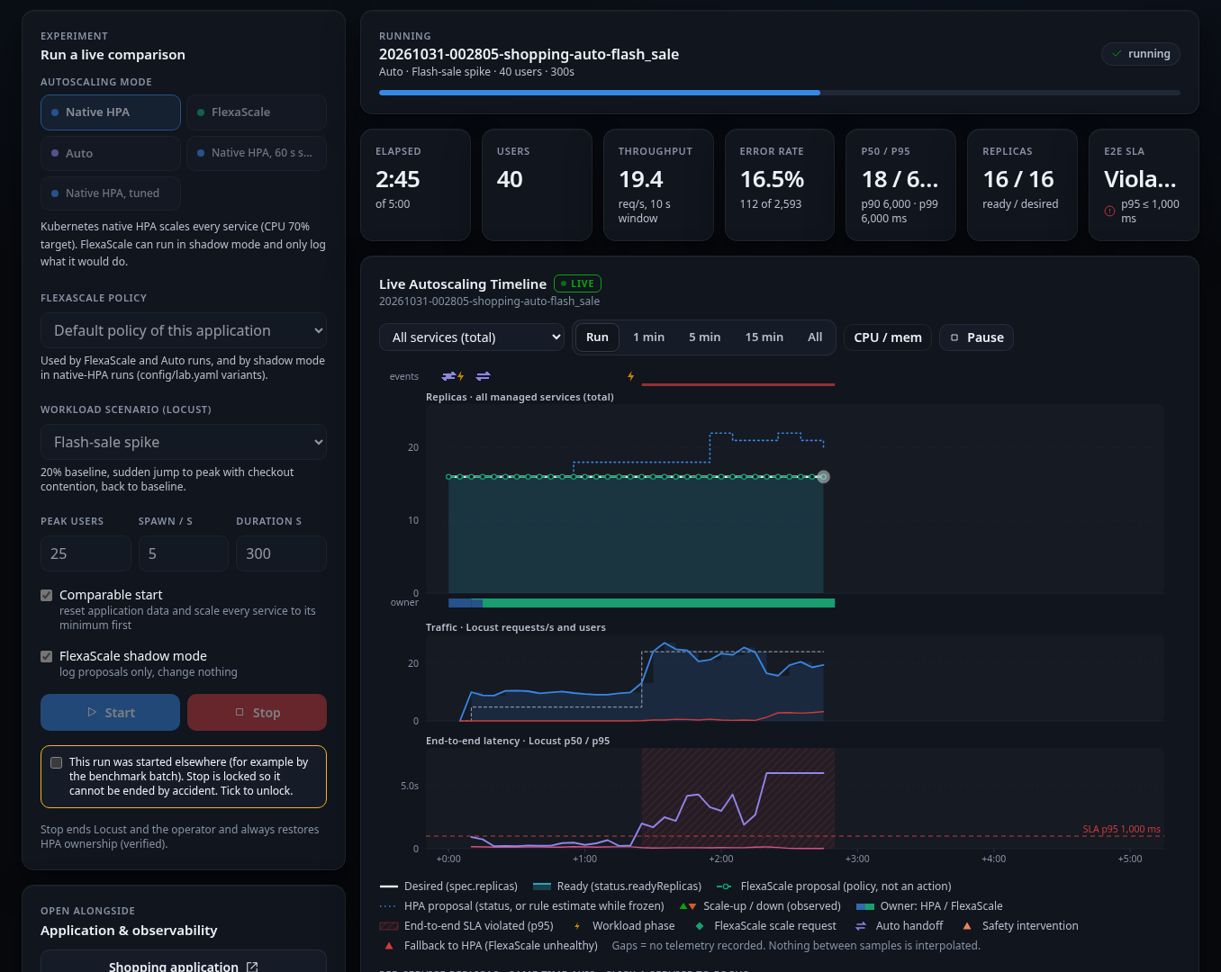
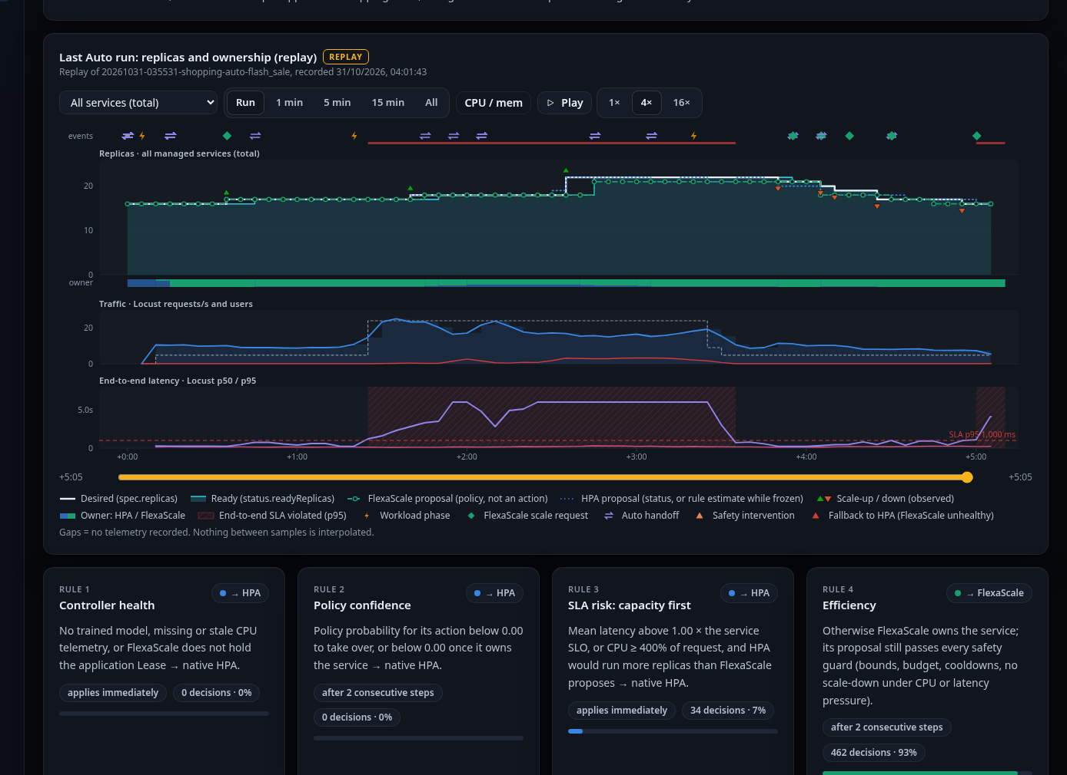
Appendix A: Code and Demo
Demo screenshots from the control center
Auto mode page: owner band, hand-offs and rule usage (SLA risk 7%, efficiency 93%)
Live lab during an Auto-mode flash sale
Notes:
Left: the Live lab with tiles, the live autoscaling timeline and per-service replicas. Right: the Auto mode page after the SLA-risk run, showing which controller owned each service and why.

Slide 24
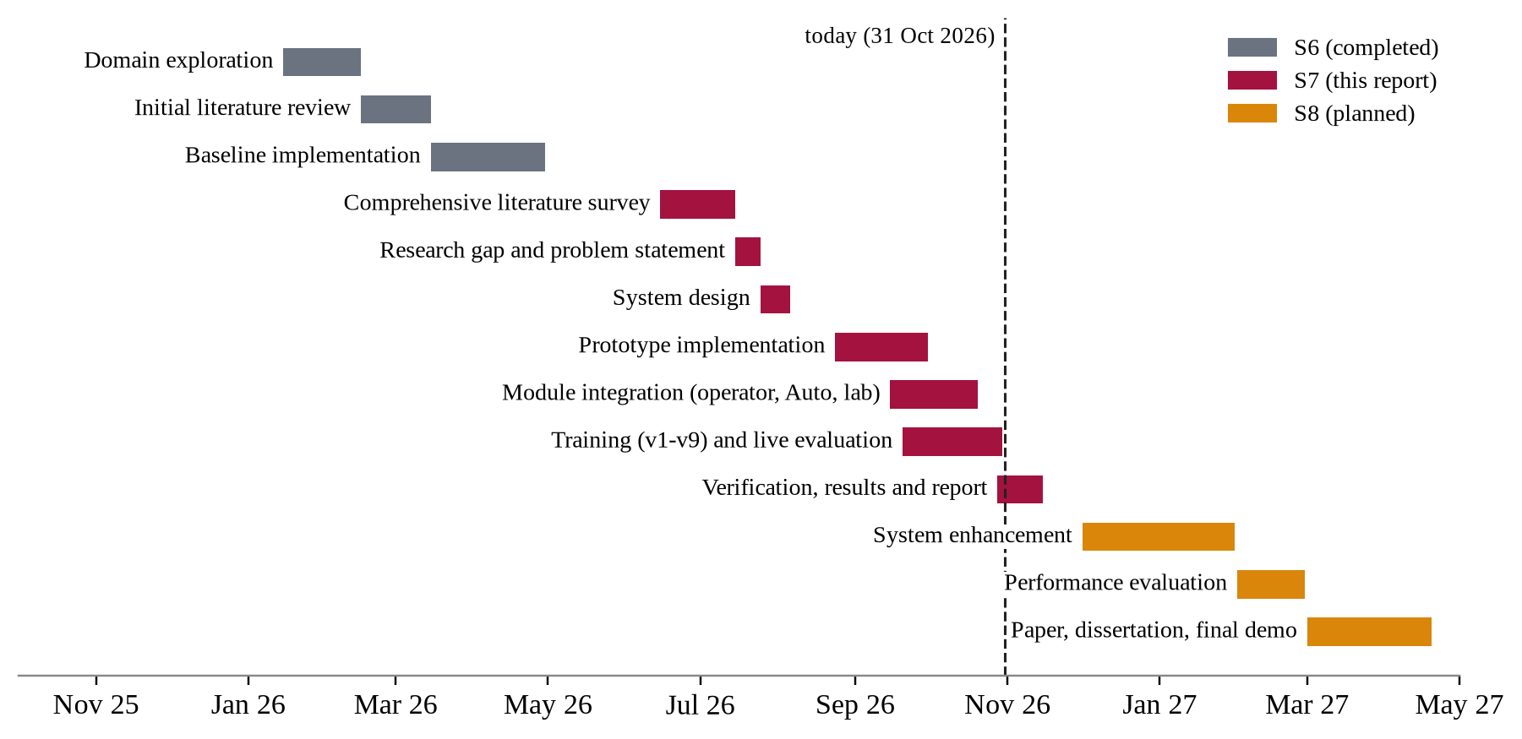
Project Time Line
Notes:
S6 covered exploration, the first literature review and a baseline. S7 covered the survey, design, implementation, training, evaluation and this report. S8 will add the enhancements, a larger evaluation, the paper and the final demonstration.

Slide 25
Reference
[1] J. Santos et al., “Gwydion: Efficient auto-scaling for complex containerized applications in Kubernetes through RL,” JNCA, vol. 234, 2025.
[2] H. Ahmad et al., “Towards resource-efficient reactive and proactive auto-scaling for microservice architectures,” JSS, vol. 225, 2025.
[3] V. Pandey, “RL-based autoscaling for cost and performance optimization in Kubernetes clusters,” 2025.
[4] Y. Shi et al., “AdaptScale: An adaptive data scaling controller …,” FGCS, vol. 105, pp. 814-823, 2020.
[5] G. El Haj Ahmed et al., “KubCG: A dynamic Kubernetes scheduler for heterogeneous clusters,” SPE, vol. 51, no. 2, 2021.
[6] F. Rossi et al., “Horizontal and vertical scaling of container-based applications using RL,” IEEE CLOUD, 2019.
[7] H. Qiu et al., “FIRM: An intelligent fine-grained resource management framework for SLO-oriented microservices,” OSDI, 2020.
[8] K. Rzadca et al., “Autopilot: Workload autoscaling at Google,” EuroSys, 2020.
[9] Y. Zhang et al., “Sinan: ML-based and QoS-aware resource management for cloud microservices,” ASPLOS, 2021.
[10] J. Park et al., “GRAF: A GNN based proactive resource allocation framework for SLO-oriented microservices,” CoNEXT, 2021.
[11] S. Luo et al., “Characterizing microservice dependency and performance: Alibaba trace analysis,” SoCC, 2021.
[12] Y. Gan et al., “An open-source benchmark suite for microservices …,” ASPLOS, 2019.
[13] J. Schulman et al., “Proximal policy optimization algorithms,” arXiv:1707.06347, 2017.
[15] A. Raffin et al., “Stable-Baselines3: Reliable RL implementations,” JMLR, vol. 22, 2021.
[19] Kubernetes Authors, “Horizontal Pod Autoscaling,” kubernetes.io documentation, 2026.
Notes:
Full references, in IEEE format, are in the project report.

